Slide 1

Good
Class Notes
Comp II with
david hodges

Slide 2
Good Notes are like
Purposeful Summaries
They don’t try to summarize everything.
They reshape the narrative of the original material to suit the purpose of the summarizer.
They remind the student who reviews them later what was most important and memorable about the class.
They are the “takeaways.”

Slide 3

Both sets of notes were from the same class, October 5, 2021
This is the graphic
that illustrated the research process for
that class.

Slide 4
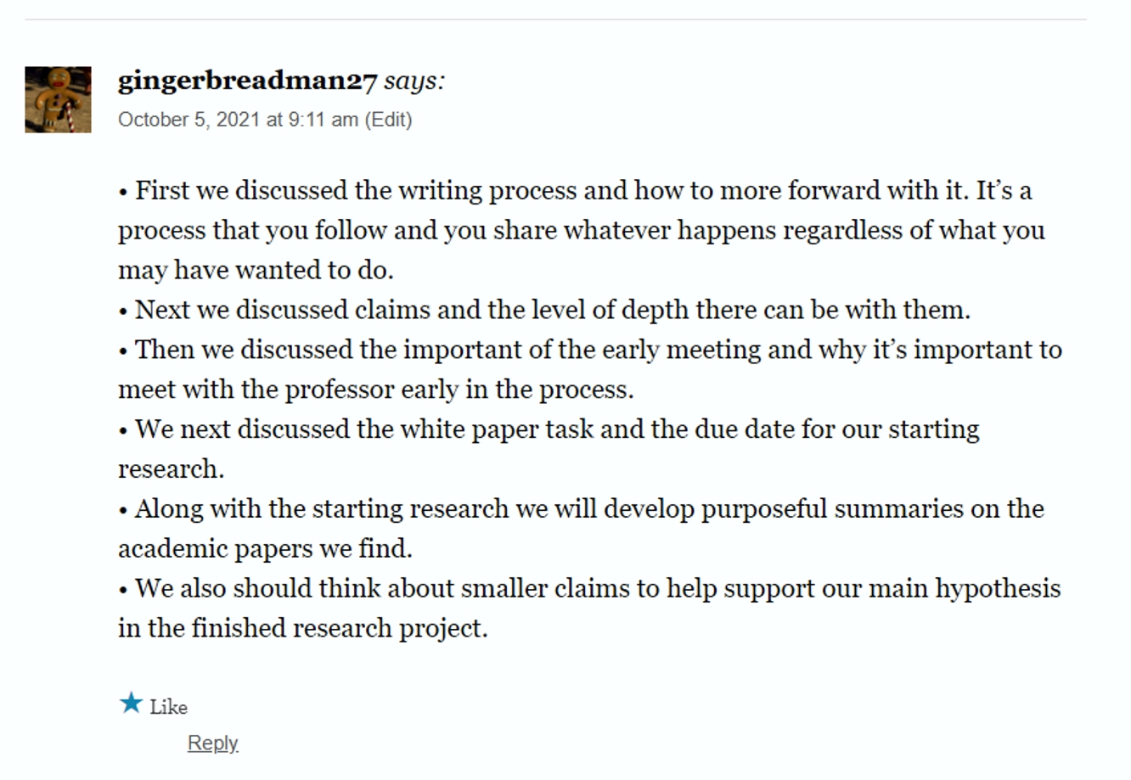
Bad
Notes describe
“What we talked about.”

Slide 5
Bad
Notes
describe
“What we
talked about.”
Bad Notes
name topics instead of making claims.

Slide 6
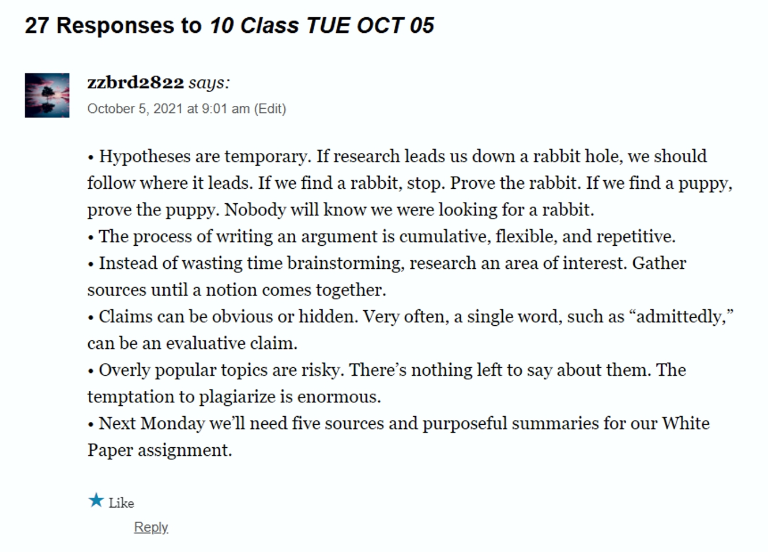
Good Notes, like good essays, make clear, specific claims

Slide 7
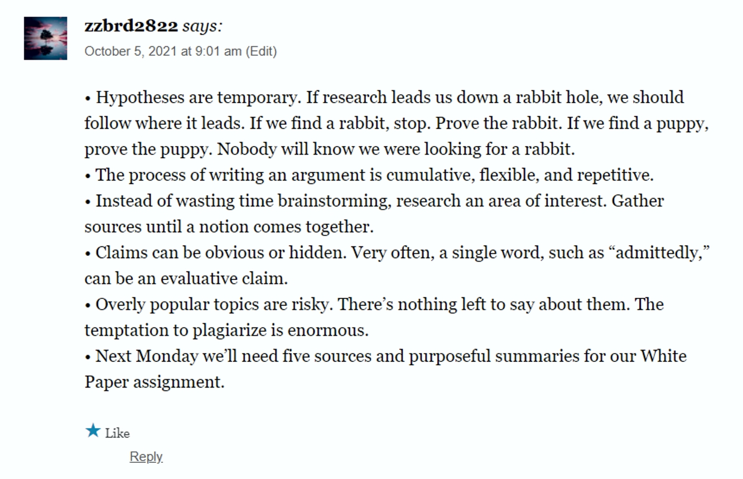
Good
Notes
make clear, specific claims.
They are
a series of Purposeful Summaries.

